Slide 1
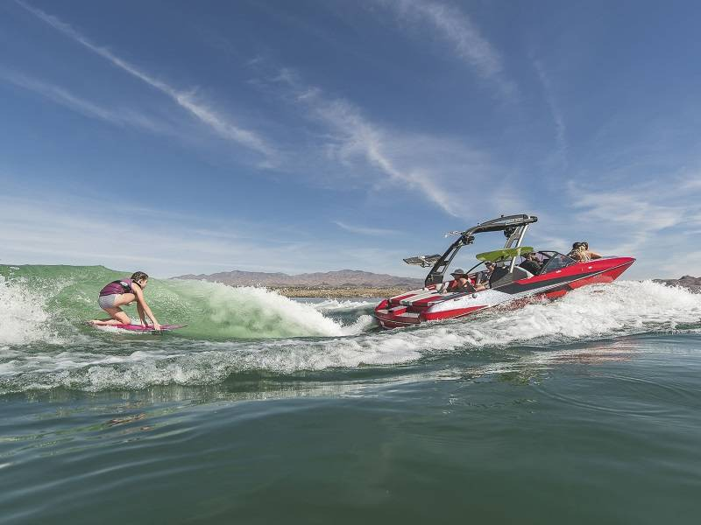
Wake Boats / Wake Surfing

Slide 3
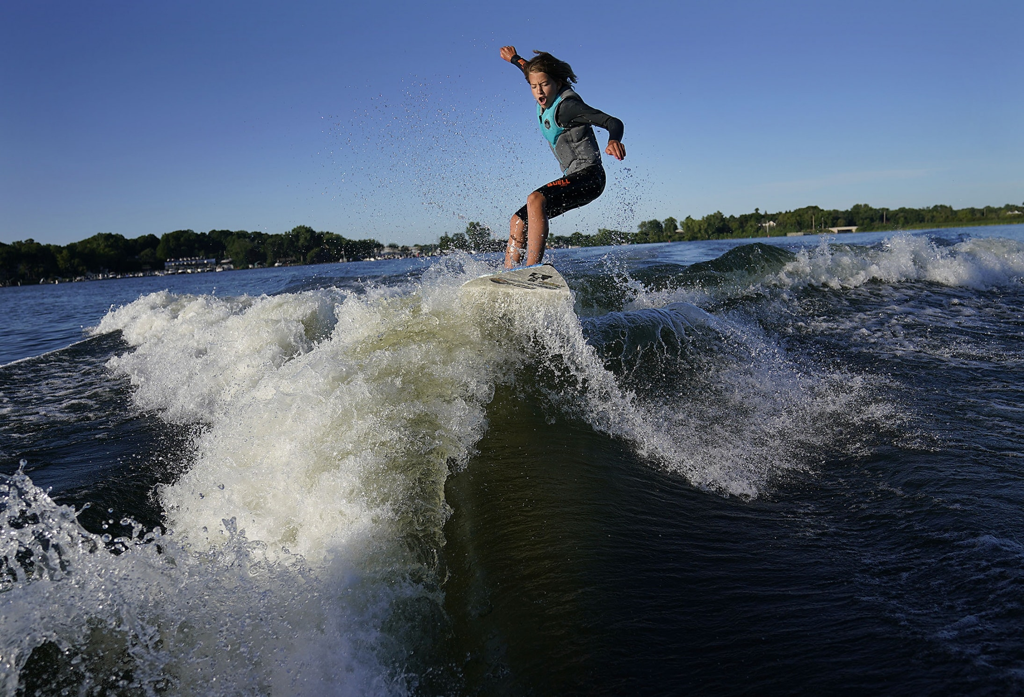
Wake Boats / Wake Surfing

Slide 4
What is a Wake Boat?
Generally 20-26+ long
Often employs an inboard motor – 4-500+ HP
Has a deck in back to step off to get onto board
Carries 1000+ pound of water ballast to help generate large waves
Uses shaping devices to form larger waves

Slide 5
What is Wake Surfing?
A wake surfer starts by using a short rope get pulled behind the boat which is going about 10-14 mph
Once up and stabilized, the wake surfer tosses the rope back into the boat
Wake surfing then continues as the surfer goes downhill on the large wake

Slide 6
Potential Problems
Wave Size – effect on shoreline (erosion, loon habitat, etc.)
Study by U of M (St Anthony Falls Laboratory) outlines potential problems)
Bottom Disruption – stirring up sediment can lead to increase phosphorous in lake waters
Disruption of other recreational activities (i.e. paddleboarding, sailing, canoeing, swimming, fishing, boating, etc.)
Ballast discharge can lead to release of AIS
Boats often carry large sound systems – nuance noise

Slide 7
What to do? Options to regulate Wake Boats/Wake Surfing
Convince the DNR to Restrict the use of wake boats and wake surfing on a given lake
Petition
Provide information to county officials – petition, “Water Surface Use Management” package
County Meetings – public input
County recommendations to DNR
DNR sets policy for given lake
Contact State Legislators and express opinions on Wake Boat use on inland lakes in preparation for future regulations/laws

Slide 8
Wake Boat Contact Information
May 2022
If you agree that wake boats and wake surfing can be detrimental to the waters of Caribou Lake, the Caribou Lake property Owners Association suggests that you contact your state representatives to express your opinion. There is currently no pending legislation on wake boat restrictions, but it is expected that legislation will be introduced sometime in the future. It is important to have opinions on record so they can be considered when legislation is written.
Contact with legislature can be made by telephone and e-mail. As a property owner in Cook County, please contact your state senator and house representative from that area. If you also own property in other parts of Minnesota, you can also contact your representatives for that area.

Slide 9
Points to consider when contacting state legislative representatives:
High waves created by wake boats can cause shoreline erosion and negatively impact loon nesting areas along the shore.
High waves created by wake boats can disrupt recreational lake activities such as paddleboarding, canoeing, sailing, fishing, swimming, etc.
Wake boats have high horsepower engines. Propeller wash can disturb contained sediment at the bottom of shallow lakes and can cause chemicals such as phosphorous to be redistributed in lake water leading to algae bloom.
Wake boats generally employ water ballast tanks which are filled and emptied into the waters of the particular lake where the boat is being used. This can lead to movement of aquatic invasive species (AIS) from one lake to another.

