Slide 1
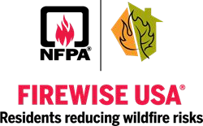
Firewise Principles
Managing Our Forests
With Spruce Budworm

Slide 2
Wildfire History in Northern Minnesota
Fire has been present on our landscape for thousands of years.
Managing fuel loads is the most effective way to reduce wildfire risk in our communities. Native Americans lived with and used wildfire to actively and effectively manage the landscape for thousands of years. Examples include managing for moose habitat and blueberries. Both of which require wildfire disturbances.
For over 100 years we have been suppressing all wildfire activity in northern Minnesota, this has led to an extreme buildup of fuel loads (balsam fir) and lack of species diversity in our forests.
Spruce budworm is also a native species that has been a part of th ecological process for thousands of years. It is not an invasive species.

Slide 3
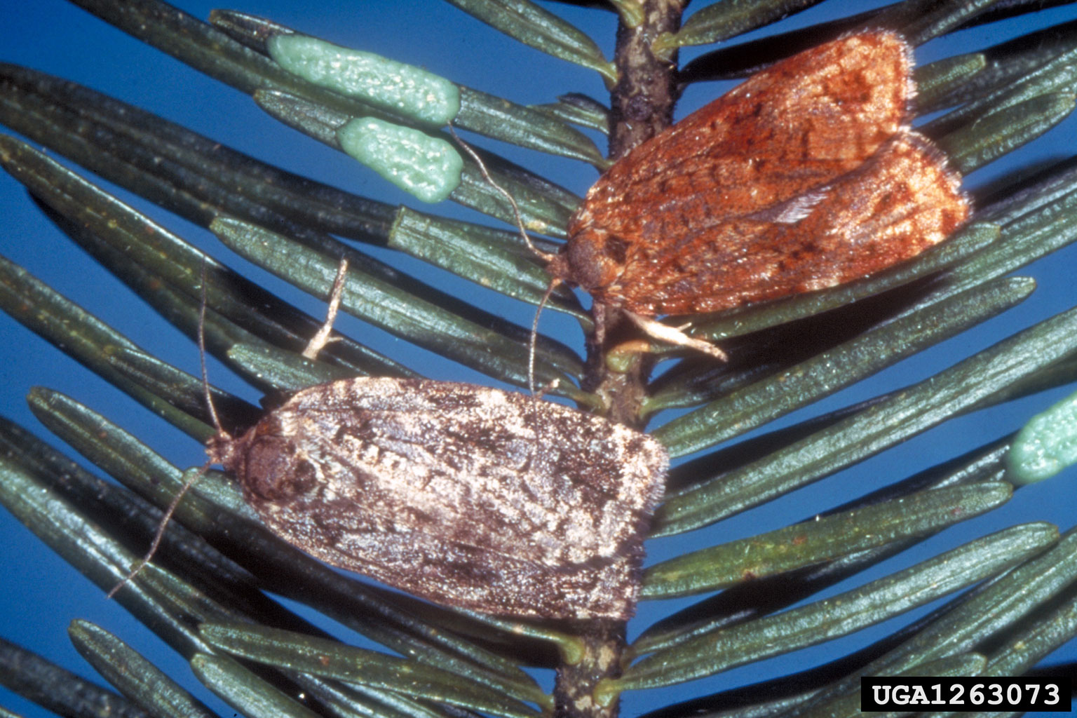
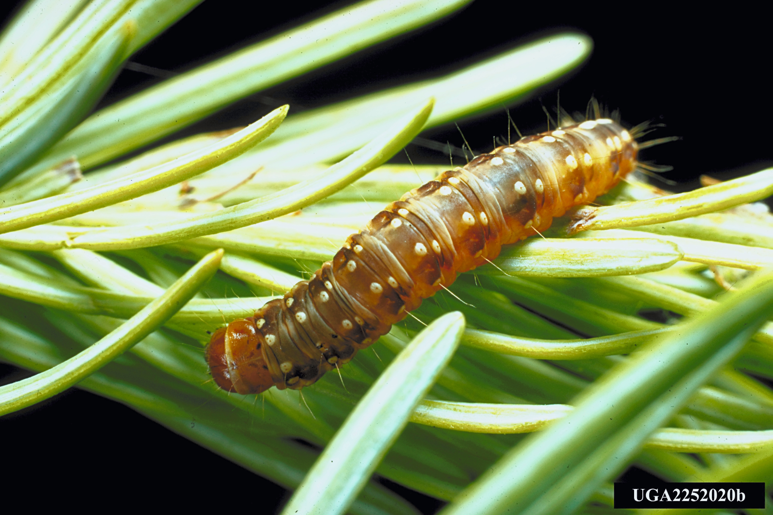
What is Spruce Budworm?
Spruce Budworm is a native caterpillar/moth. Its preferred host species is balsam fir.
Image credit: USDA Forest Service

Slide 4
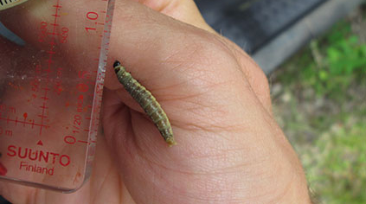
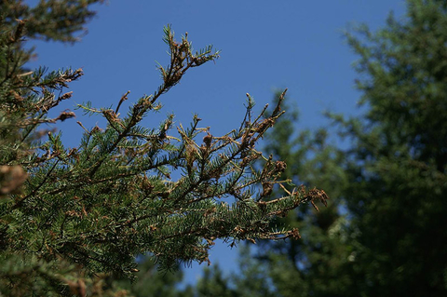
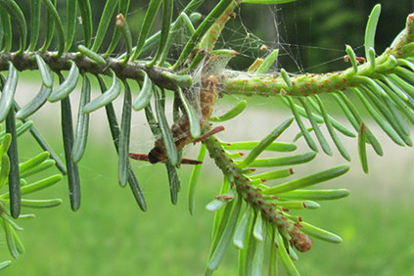
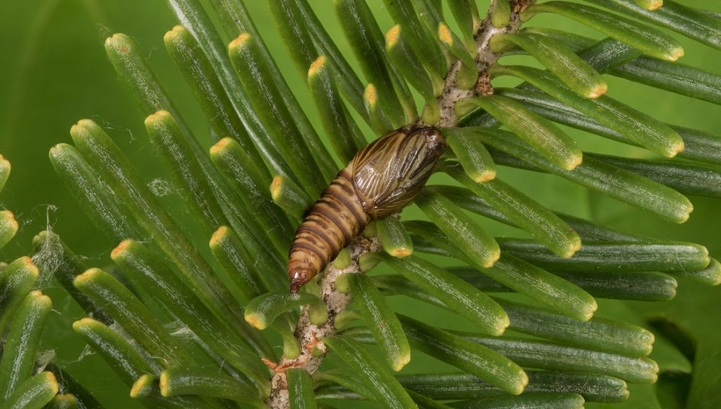
Image Credit: Province of British Columbia

Slide 5
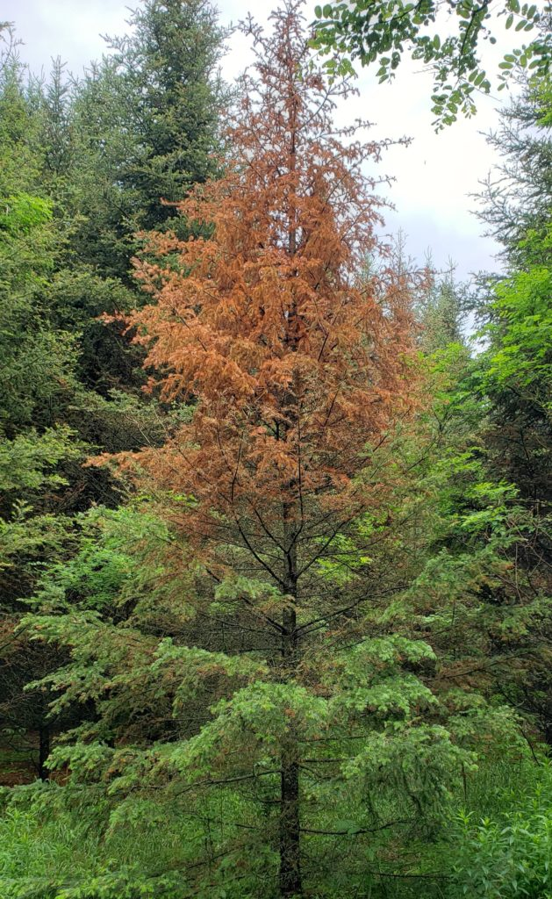
Balsam Fir Susceptibility

Slide 6
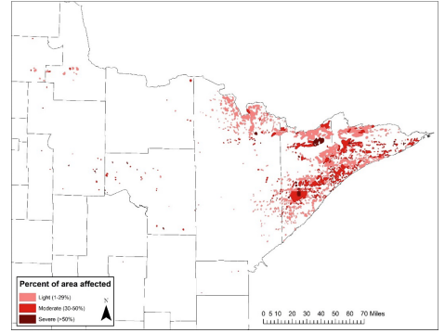
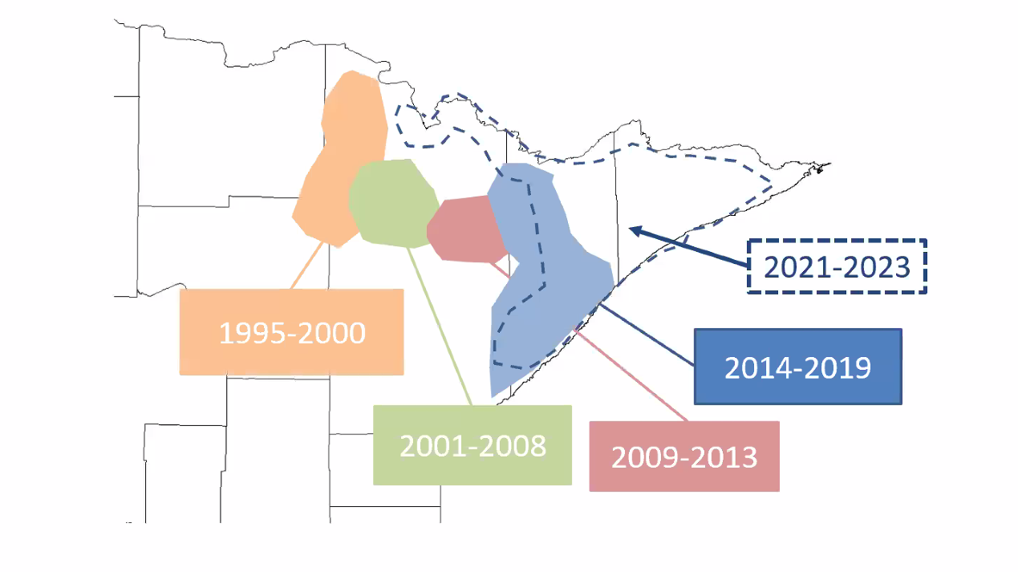
MAPS!

Slide 7
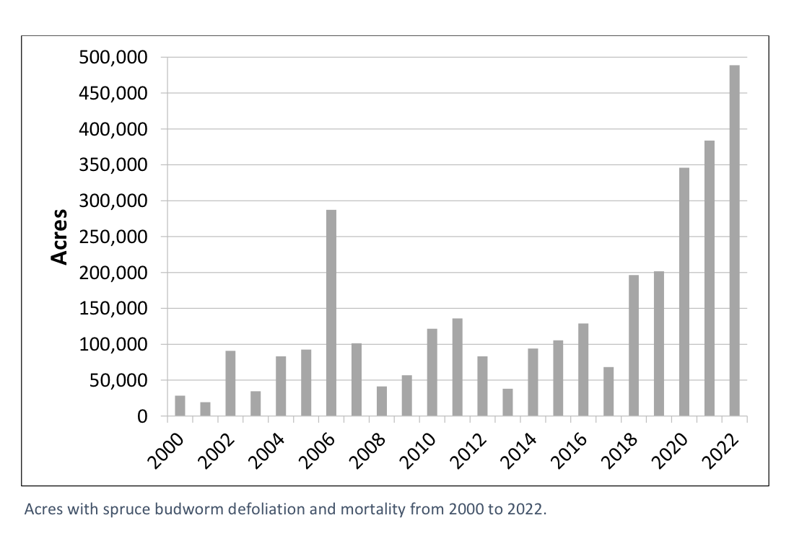
Current Outbreak
2022 total defoliation/mortality: 488,838 acres
Highest number of acres impacted since 1995

Slide 8
Impact of Spruce Budworm on Trees
Trees dedicate most energy to producing new buds each spring
Larvae eat new buds → tree loses all of the energy put into growth→ tree dedicates significant energy to repair itself → tree has little energy left for other processes→ defoliation and mortality
Impacts are compounded by other stressors such as drought, suppression, more frequent freeze/thaw events
This results in widespread losses of balsam fir and white spruce

Slide 9
Impact of Spruce Budworm on Forest
Balsam fir trees are the most volatile fuel in Minnesota's forests even when healthy.
Wildfire suppression has lead to huge a huge build up of balsam fir stands creating extreme fuel loads.
With the wide scale mortality associated with spruce budworm these issues multiply creating even greater risk for extreme wildfire activity.
Overall lack of diversity and resilience

Slide 10
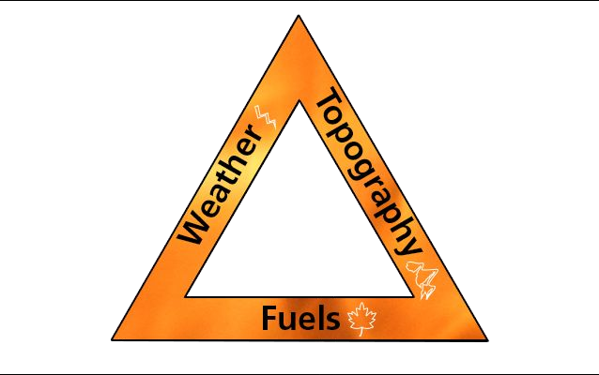
3 Factors Influence Wildfire Potential
Topography – Slopes exponentially increase wildfire potential to spread
Weather – Wind, relative humidity, and temperature
Fuel – Vegetation and structures
Extreme wildfire behavior normally consists of a combination of extended drought, high winds, high temperatures and excess fuel loads. The fuel loads are what we can directly influence and manage on our land.

Slide 11
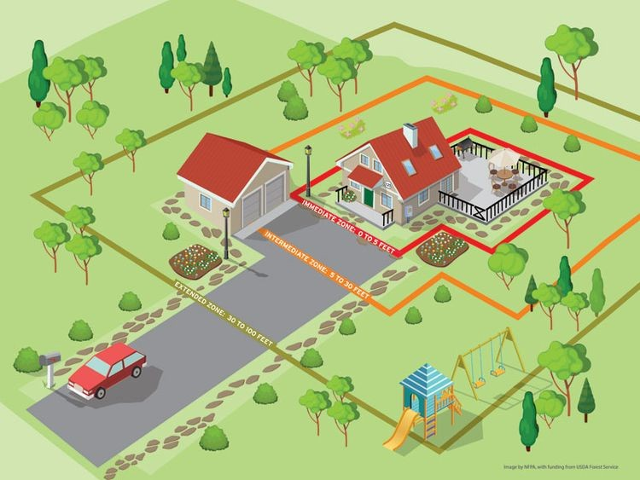
Mitigation on our Properties
A home’s ignition risk is determined by its immediate surroundings (fuel load) and the home’s construction materials.
There are 4 zones to manage on our properties.

Slide 12
Home Zone
Harden your home against wildfire.
Use non-flammable or low flammability construction materials
Storage of flammable materials should be kept away from structures
Never line your structures foundation with mulch or other flammable materials
Consider closing off decks and exposed foundations
Remove duff, leaves and other organic material build up from roofs, porches, foundations

Slide 13
Zone 1
0-30 Feet From Structures, Driveways and Roads
This area is the most important to actively manage for vegetation. ALL balsam fir, alive or dead, should be removed from this area.
Smaller DBH conifers present the highest risk and should be prioritized for removal.
Other conifers should also be considered for removal or limbed up at least 6’ off the ground. No limbs should ever be in contact with structures.
Lawns should be well maintained and mowed often. Vegetation should be limited to carefully spaced (10 feet) low flammability species.

Slide 14
Zone 2
30-100 Feet from Structures
The majority of balsam fir should be removed from this area, prioritizing small DBH trees first.
All conifers should be limbed up at least 6 feet from the ground.
Remaining trees should have no less than 10 feet spacing between them. The crowns of conifers should never be touching.
Prioritize low flammability species.

Slide 15
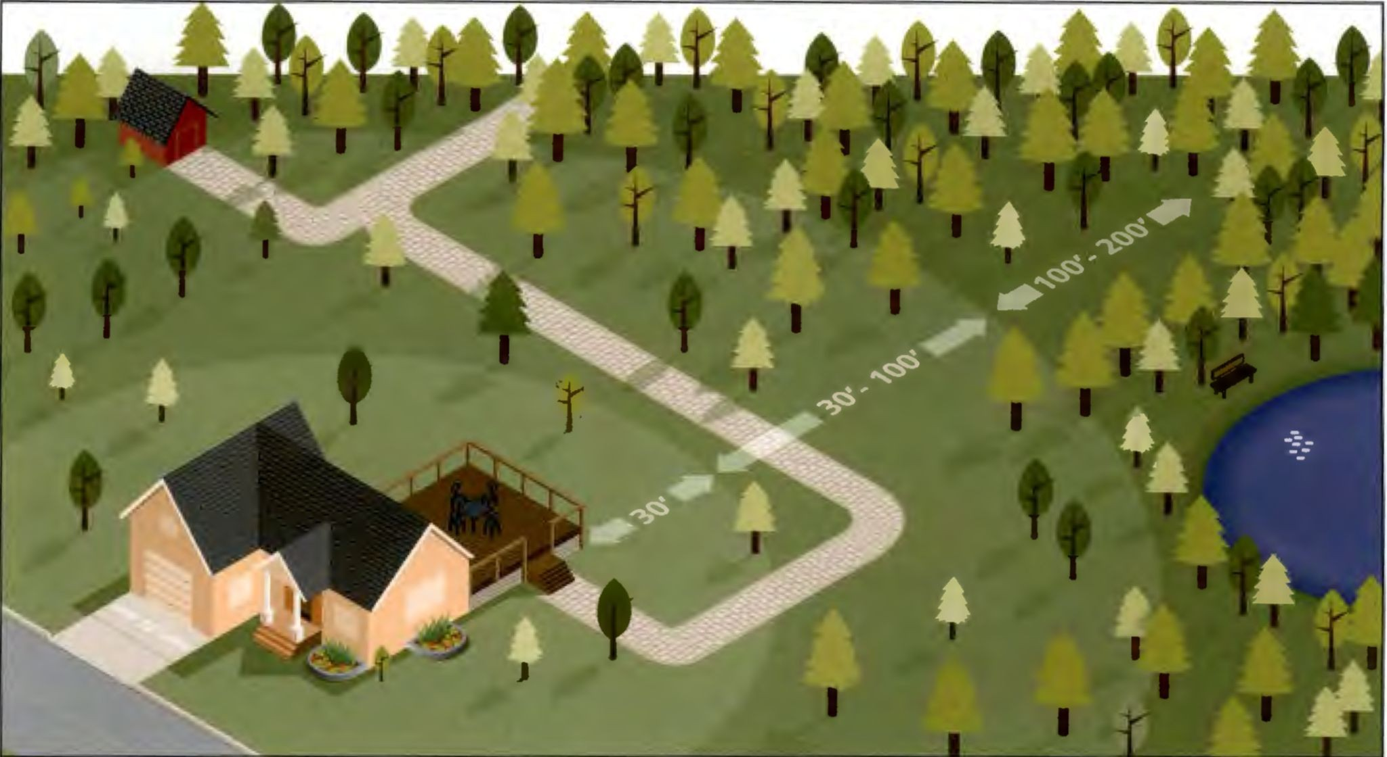
Zone 3
100 Feet and Beyond
Prioritize 10 foot spacing and limbing of conifers.
Thin conifers so crowns are not touching.
Promote low flammability species.

Slide 16
Resources for Landowners
Cook County has 7 Firewise Brush Disposal Sites that Residence can bring hazardous fuels removed from properties. Refer to the Cook County Firewise website for locations.
https://cookcountyfirewise.org/information-for-homeowners/brush-disposal/
Firewise inspections can be requested and will be completed with no cost to the homeowner.
Communities interested in becoming Recognized Firewise Community can request info and application assistance from Cook County Firewise.
.

Slide 17
Cook County Firewise Contact
Aaron Mollin-Kling
Cook County Firewise Coordinator firewise@co.cook.mn.us
Phone: 218-387-4133
https://cookcountyfirewise.org/

Slide 18
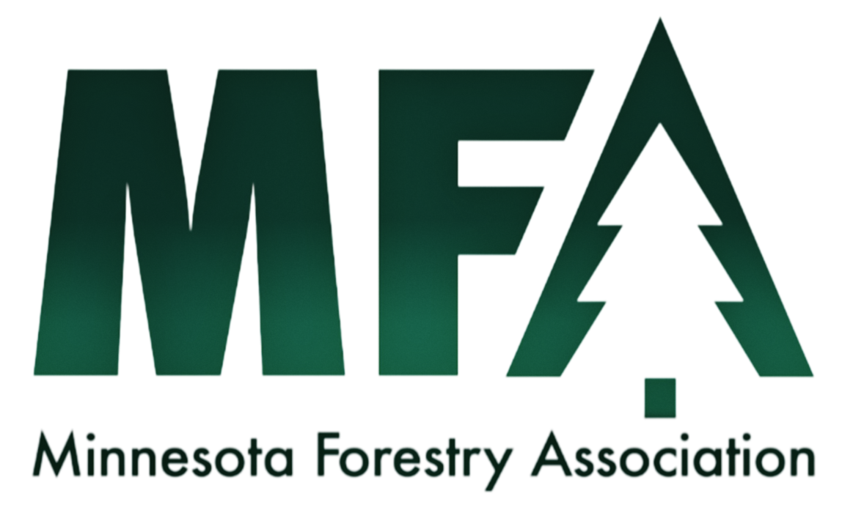
Additional Contacts
And Partners
Cook County SWCD
www.cookswcd.org
218-387-3647
Sarah Waddle
Local Extension Educator, Cook County
swaddle@umn.edu
218-387-3015

