Slide 1
Caribou Lake Property Owners’ Association Annual Meeting
August 30, 2025, 10:00- noon
Lutsen Town Hall
***World’s Best Donuts and Coffee***
AGENDA
Introduction of Board Members
Comments from Commissioner Storlie (10:00 – 10:10)
Guest Speaker, Steve VanKekerix, Cook County Firewise (10:10 – 10:40)
Approve Minutes of 2024 Annual Meeting (10:40 – 10:45)
Nomination and Election of Board Members (10:45 – 10:50), nominees: Charlie Austin, Fred Morris, Jeanne Anderson, Julie Bittinger (withdrawn), Larry Mullen, Mike Nicklow, Sharon Hexum-Platzer (7 of 11 board members)
Treasurer’s report – Charlie Austin (10:50 – 11:00)
    link for paying dues online: https:/ caribou.mnlakesandrivers.org/membership/
CCCoLA report - Irene Mullen (11:00-11:10)
Water Quality Report, Larry Mullen (11:10 – 11:25)
Rusty crawfish update – Tom Rider (11:25 to 11:45)
    what was done this summer,
    Plan for future years
Name Change? (11:45 – 11:50)
Questions, comments from the floor 11:50
Adjourn

Slide 2
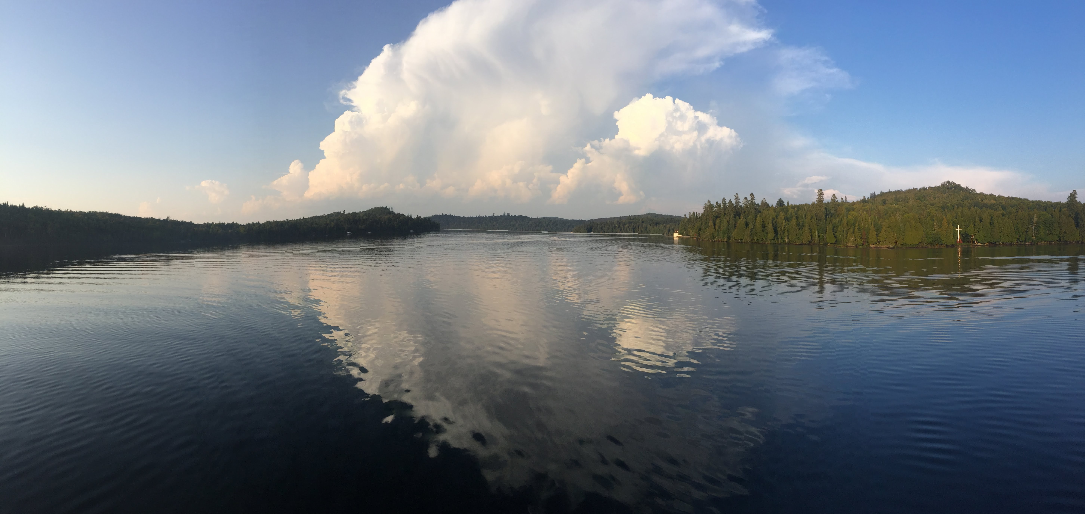
CLPOA Treasurer's Report
9/1/24 to 8/30/25

Slide 3
Statement of Activities
Income
Dues | $1,790.17
Donations – Rusty Crayfish Fnd | 2,260.00
SSD reimbursement | 3,750.00
Interest | 2.63
Total Income | $7,802.80
Expenses
Shipping, Postage | $72.00
WQ testing | 1620.82
Events | 342.79
Membership/Dues | 340.04
Website | 110.00
Misc. | 127.85
Total | $2,613.51
Net Inc/Exp b/4 Rusty Crayfish | $5,189.29
Rusty Crayfish Expenses | $7,270.43
Net Income/Expense | $(2,081.14)
8/31/24 to 8/30/2025

Slide 4
Rusty Crayfish Expenses
Bait, Tackle & Supplies | $ 272.43
Outboard Motor | 3,019.00
Repairs | 229.00
Crawdaddies | 3,750.00
Total | $7,270.43
8/31/24 to 8/30/2025

Slide 5
Change in Cash Position
Opening balance 9/1/24 | $2,828.50
Additions | 7,802.80
Subtractions | 9,883.94
Ending balance, 8/28/25 | $ 747.36
Difference (decrease) | $(2,081.14)
9/1/24 to 8/28/2025

Slide 6
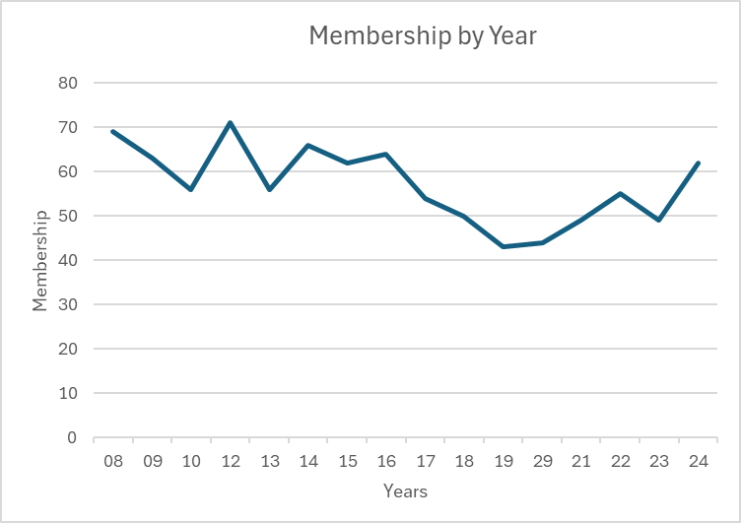

Slide 7
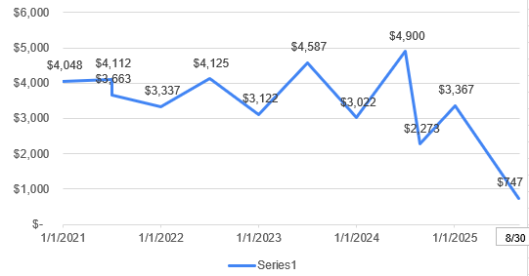
Cash Balances 2021 to today

Slide 8
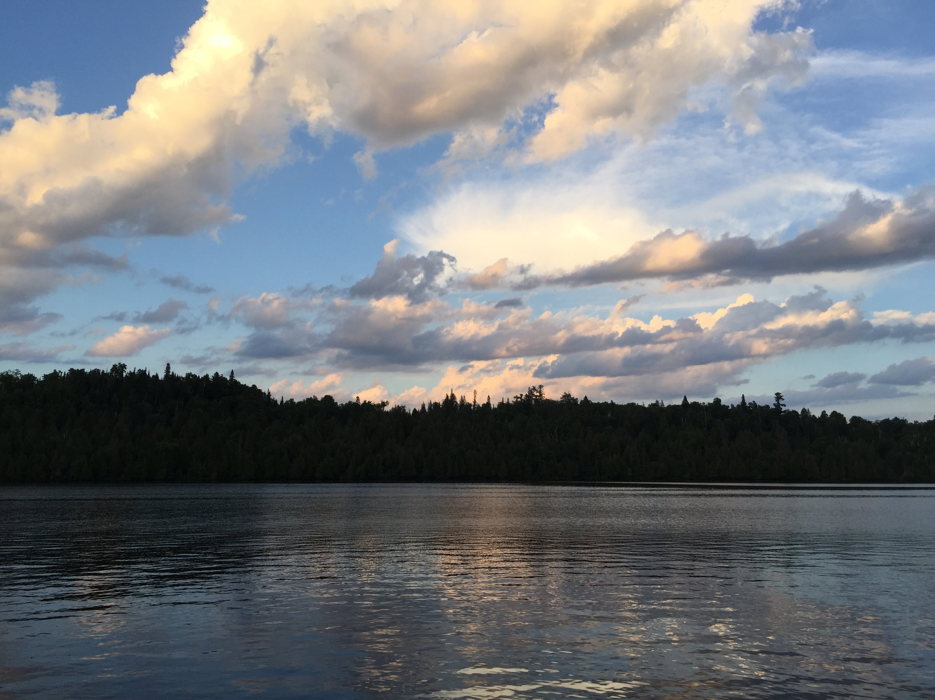
How to pay dues
Pay to me today.
Mail to PO Box 11, Lutsen MN 55612
Pay with credit card on our website:
  https://caribou.mnlakesandrivers.org/
THANK YOU!

Slide 9
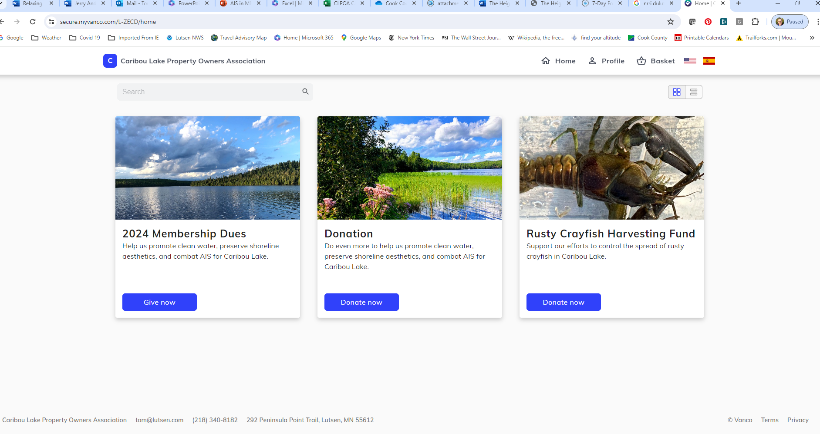
Caribou.mnlakesandrivers.org

Slide 10
Cook County Coalition of Lake Associations
21 board members made of Lake Associations, Road Associations and individuals
Protect Preserve Participate - Lakes of Cook County

Slide 11
CCCoLA Meetings
Second Thursday of each month
4 in person meetings in person
Zoom during the rest of year
Updates from AIS and SW – as needed
County Updates from Ann Sullivan
Updates and presentations
Anyone can attend meetings - coffee and snack provided

Slide 12
Upcoming Meetings
NEXT MEETING - Thursday 9/11, 10:00-noon Cook Cty Community Center
DNR AIS Coordinator Doug Jenson and Mike Nicklow – Let’s Plant Trees!
October/November Zoom meetings topic – sulfide mining
  Friends of the Boundary Waters
  Water Legacy
  MN Center for Environmental Advocacy
  Save the Boundary Waters

Slide 13
Community Outreach
Fisherman’s Picnic – along side with Cook Cty AIS and SW
Canoe Races
Take a Kid Fishing
WTIP and Cook County News Herald

Slide 14
Surface water usage is big concern for members
Health of the lake
Water is used for their cabin
Erosion
Wildlife
GET the LEAD OUT

Slide 15
Cook County AIS
Boat Inspections
Check Point 4 Hours in June, 10 boats, 4 had plugs in, from out of state
Caribou Data Boat Inspection Date – 2024
Survey for Spiney Water Fleas and Calcium testing

Slide 16
Cook County Soil and Water
Algae and Cyanobacteria Presentation
Shoreland workshop
pH monitoring equipment

Slide 17
Shoreland Stewards – That’s all of us!
Cook County has over 90% of its pre European settlement wetlands
Shoreline is defined as 1000 feet from shore
MRL - score your shoreline

Slide 18
Start small – stop mowing or clearing 10 feet from shoreline moving back every year till you are at 30 feet from shoreline
Plant native flowers, shrubs, trees
SW will do site visits

Slide 19
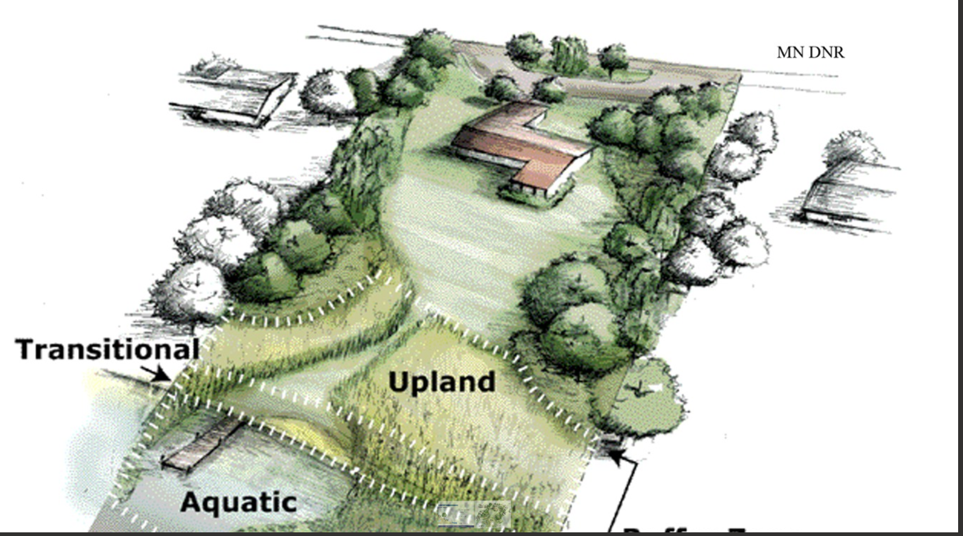

Slide 20
Gunflint Loon Project
Volunteers make observations every two weeks
Any time of the day
Divide up the lake
Monitor until the loons leave
Headed up Dr. Piper who has been monitoring loons in northern WI and seen the decline
Goal is to get data on Cook County –
Ward and Deeryard?

Slide 21
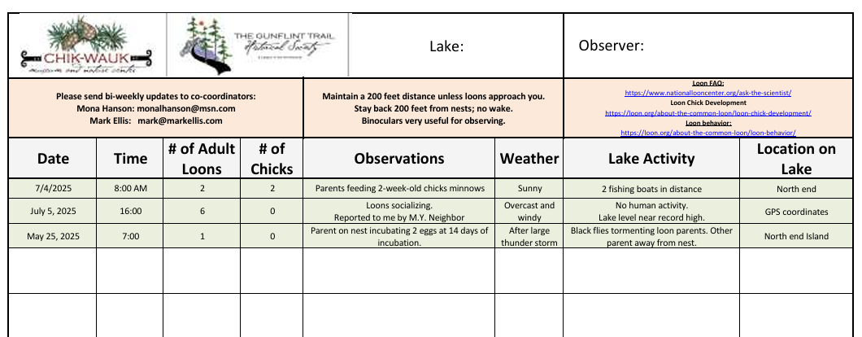

Slide 22
Water Quality Report
Phosphorus
Chlorophyll–a
Secchi Disk
Oxygen
Calcium
PH Factor

Slide 23
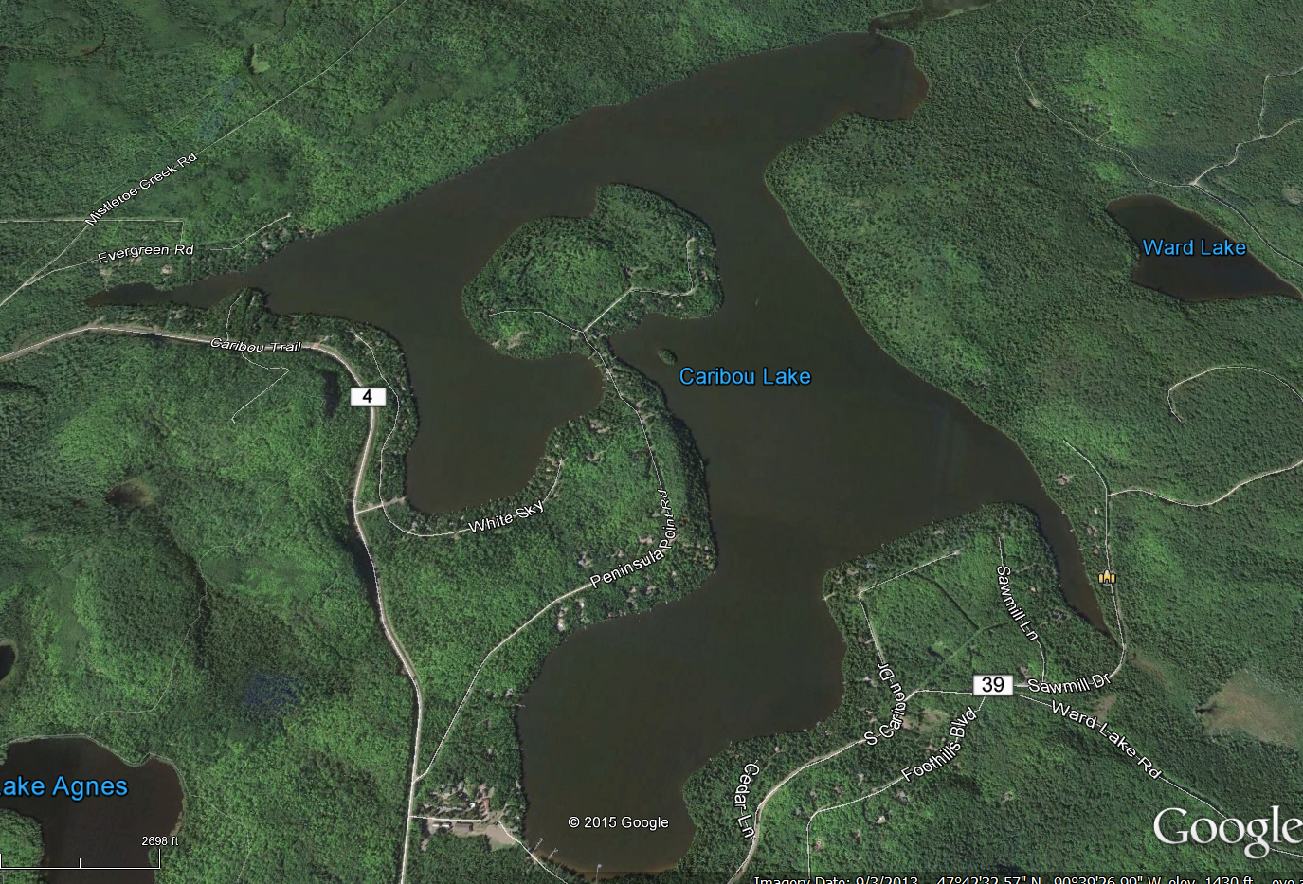
5 Sampling Sites
(Used Historically)
210
201
103
205
203

Slide 24
Phosphorus Goal 15 PPB or less

Slide 25
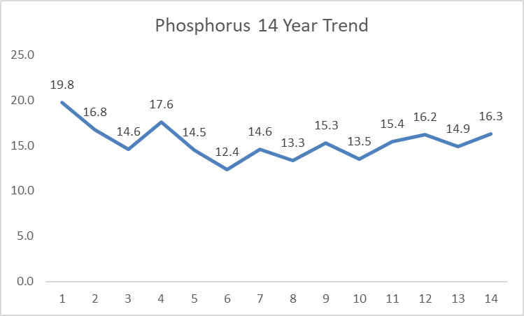
Goal or less
2012 2013 2014 2015 2016 2017 2018 2019 2020 2021 2022 2023 2024 2025

Slide 26
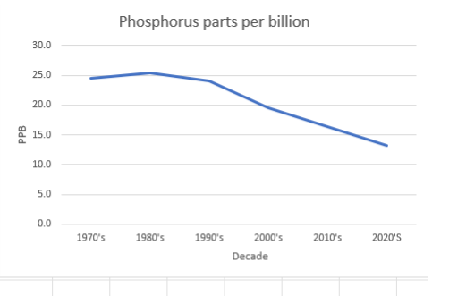
Phosphorus Testing History - site 205

Slide 27
Chlorophyll-a Goal 8 PPB or less

Slide 28
Goal
or less
2012 2013 2014 2015 2016 2017 2018 2019 2020 2021 2022 2023 2024 2025

Slide 29
Secchi Disk Goal 6 feet or more

Slide 30
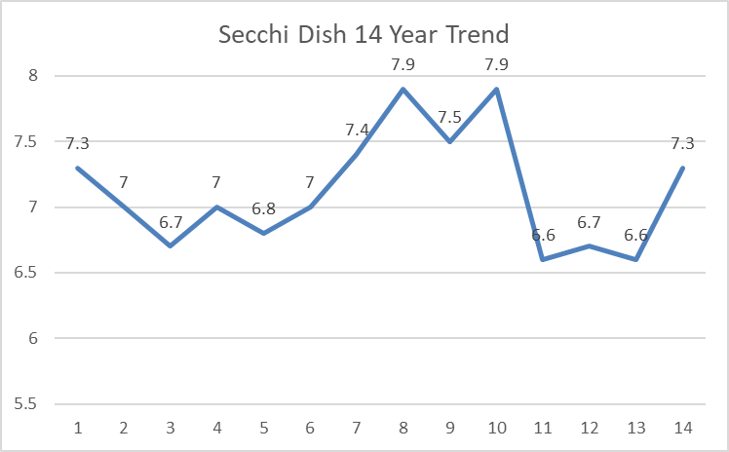
Goal
or more
2012 2013 2014 2015 2016 2017 2018 2019 2020 2021 2022 2023 2024 2025

Slide 31
Oxygen and Temperature - Site 205 (Bottom 28 feet)
Surface water normal 8 milligrams per liter or more
Date 3 feet 12 feet 24 feet
Temp Oxy mg/l Temp Oxy mg/l Temp Oxy mg/l
8/26/2025 72.3 9.4 69.4 8.1 65.1 4.5
8/20/2024 70.3 9.2 69.4 8.5 66.2 3.4
8/08/2023 73.3 9.0 72.1 7.5 59.5 0.3
7/21/2021 74.0 8.7 73.0 8.5 67.0 1.0
8/11/2019 74.0 8.6 72.0 8.7 66.0 4.0
8/07/2018 71.0 8.3 70.0 8.0 68.0 4.0
8/01/2016 75.0 8.3 74.0 7.8 71.0 3.5
8/13/2015 73.0 8.9 72.0 8.0 69.0 4.9

Slide 32
PH Factor
PH is a measure of how acidic or alkaline the water is.
•Measuring the pH factor of a lake is crucial for assessing its overall health and ability to support aquatic life.
•Most aquatic organisms, including fish, insects, and plants, have a narrow range of pH they can tolerate.
A healthy pH factor for a lake in Cook County is between 7.2 and 8.3
Caribou reading on 8/28/2025 was 7.75

Slide 33
Calcium
8/8/2016 | 7.2
8/8/2017 | 7.6
9/19/2017 | 7.4
8/7/2018 | 7.4
8/28/2019 | 7.89
8/4//2020 | 8.12
9/9/2020 | 9.03
9/10/2021 | 8.7
8/9/2022 | 6.9
9/6/2022 | 6.9
9/13/2023 8/13/2025 | 7.9 7.7

Slide 34
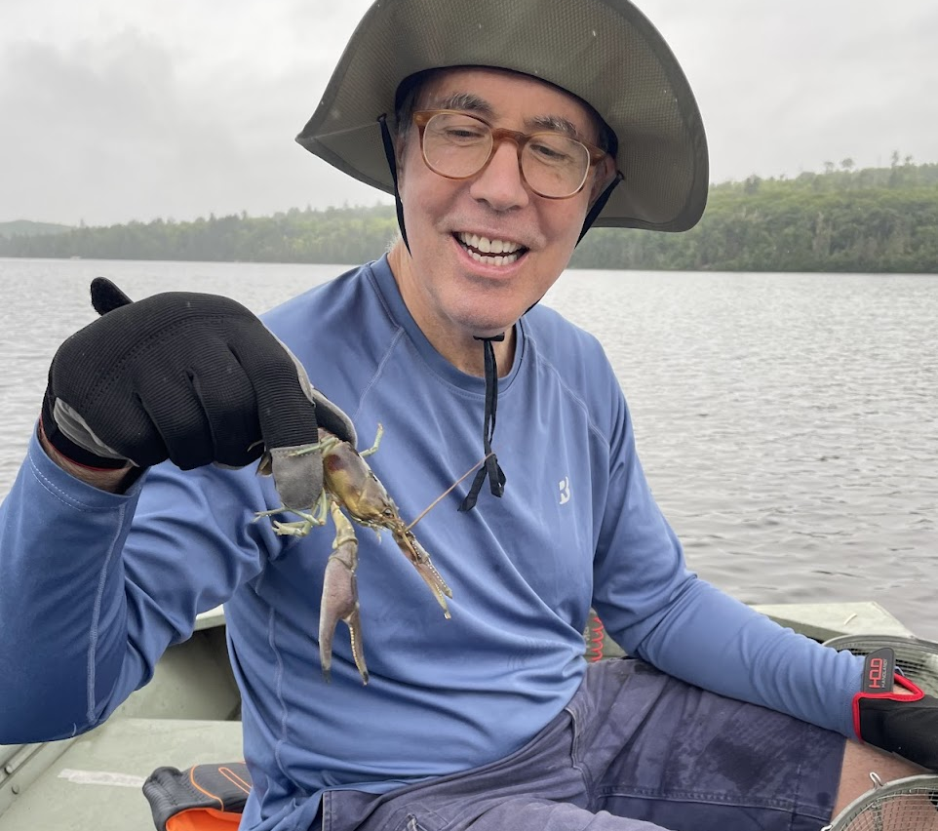
Rusty Crayfish

Slide 35
How did they get here? Where are they now?

Slide 36
What is the harm caused?
  Native crayfish eliminated
  Native grasses eliminated
    Trap sediment
    Absorb nutrient pollution
    Add disolved oxygen
    Nursing environment for fish
  Fish population declines
  Property values?

Slide 37
What can we do about it?​
  Nothing​
  Harvesting​
  Physical barrier – not allowed​
Is there evidence that Harvesting will work?​
  Some, but It's early days.

Slide 38
What did we do this summer?
Hired Crawdaddies to harvest for 6 weeks. Thank you!
Volunteer effort to supplement, ran boat July, August every other day. Loaned for summer by family of Ron McClellan and Nancy Rice. Thank you!
Larry Mullen harvested three trap lines for much of the summer. Thank you!
COP harvested most of the summer using their boat, our traps. Thank you!!
Many members harvested from their docks. Thank you!

Slide 39
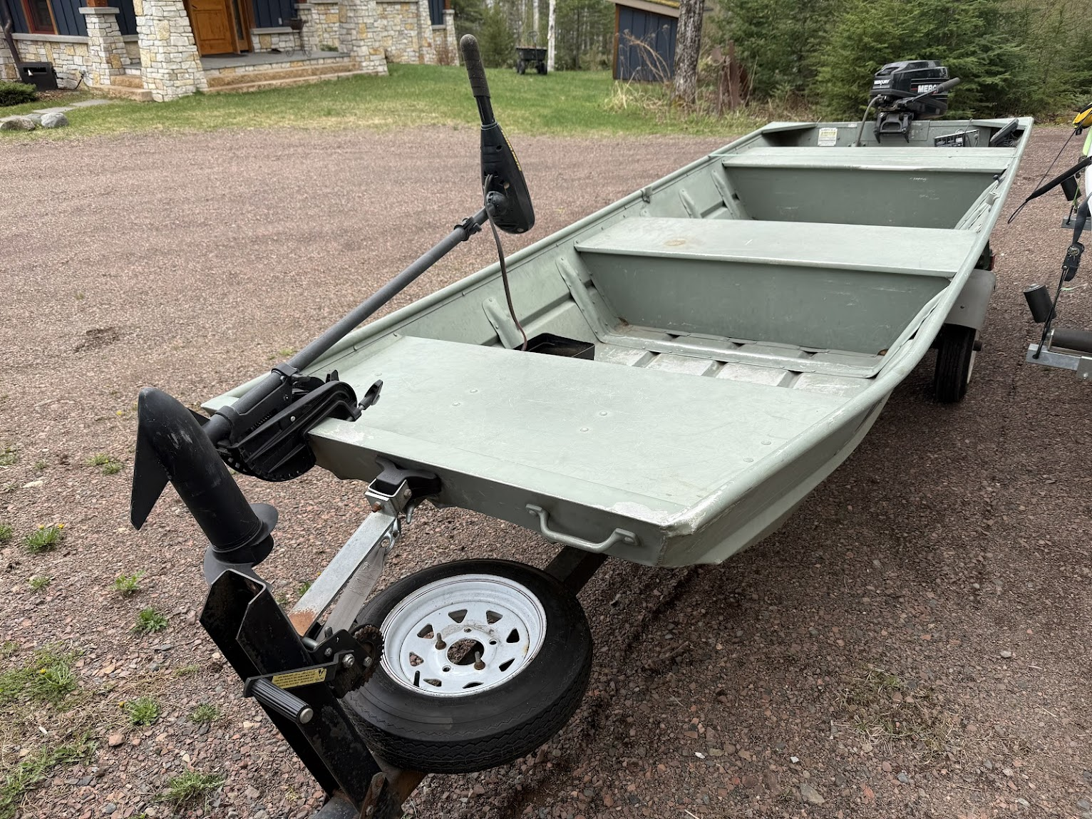
Thank you Ron McClellan, Nancy Rice, and son Kevin!!

Slide 40
Projected Harvest Totals for Summer 2025
Crawdaddies 1300 lbs
COP: 375 lbs
Volunteers, managing trap lines (Larry, Tom, Brad S): 1000 lbs
Volunteers, from docks: 400 lbs
Total 2025 = 3075 lbs = 130,000 crayfish
Total 2024: 60,000 crayfish
Total 2023: 12,000 crayfish

Slide 41
Next summer and beyond?
Continue Harvesting, ramp up efforts
SSD will continue to fund, $50 per taxpayer per year = $50 x 138 taxpayers = $6900 per year
Build Up Volunteer Harvesting Effort: purchase boat, expand volunteer pool, start harvesting earlier (started July 21 this year).
Explore internship
COP?
Crawdaddies
Engage technical, political partners: NRRI, DNR, CCCoLA, Cook Co AIS, Tribal Nations

Slide 42
New Name
Current name causes confusion, and mis-represents our mission
  HOA?
Our mission is to preserve and protect Caribou Lake. Names that better communicate our mission:
Friends of Caribou Lake,
Stewards of Caribou Lake

Slide 43
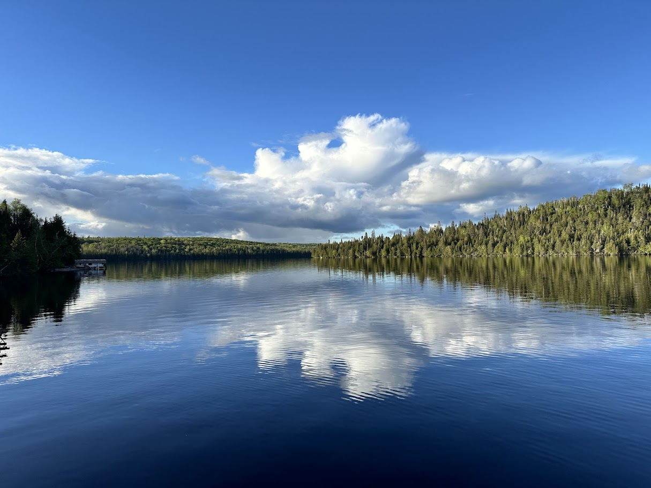
Questions?

